Slide 1
Practical Layouts in HTML + CSS
Mike Blatter

Slide 2
Legacy Layouts
Tables
Floats
Positioning
All hacks to get objects laid out, but nothing complete

Slide 3
Modern Web Layout Systems
Flexbox
1 dimensional layout system
Content First
Grid
2 dimensional layout system
Layout First

Slide 4
Flexbox
aims to provide a more efficient way of layout, alignment, and distribution of space among items in a container, even when unknown; hence flex
whole module, many properties
simple parent -> child relationship in HTML
parent is flex container
children are the flex items
declare the flex container with: display: flex;

Slide 6
CSS Grid
2-dimensional grid-layout system

Slide 7
CSS Grid: The FR Unit
Fractional Unit
Nominal unit that represents a fraction of leftover space in a container
grid-template-columns: 1fr 1fr
50/50
grid-template-columns: 1fr 1fr 1fr
33/33/33
We can also mix in other measurements like pixels or percentages

Slide 8
Grid + Flex Together
You can combine these two layout modules together
Flex can be used within Grid
Important: Grid cannot be used within Flex

Slide 9
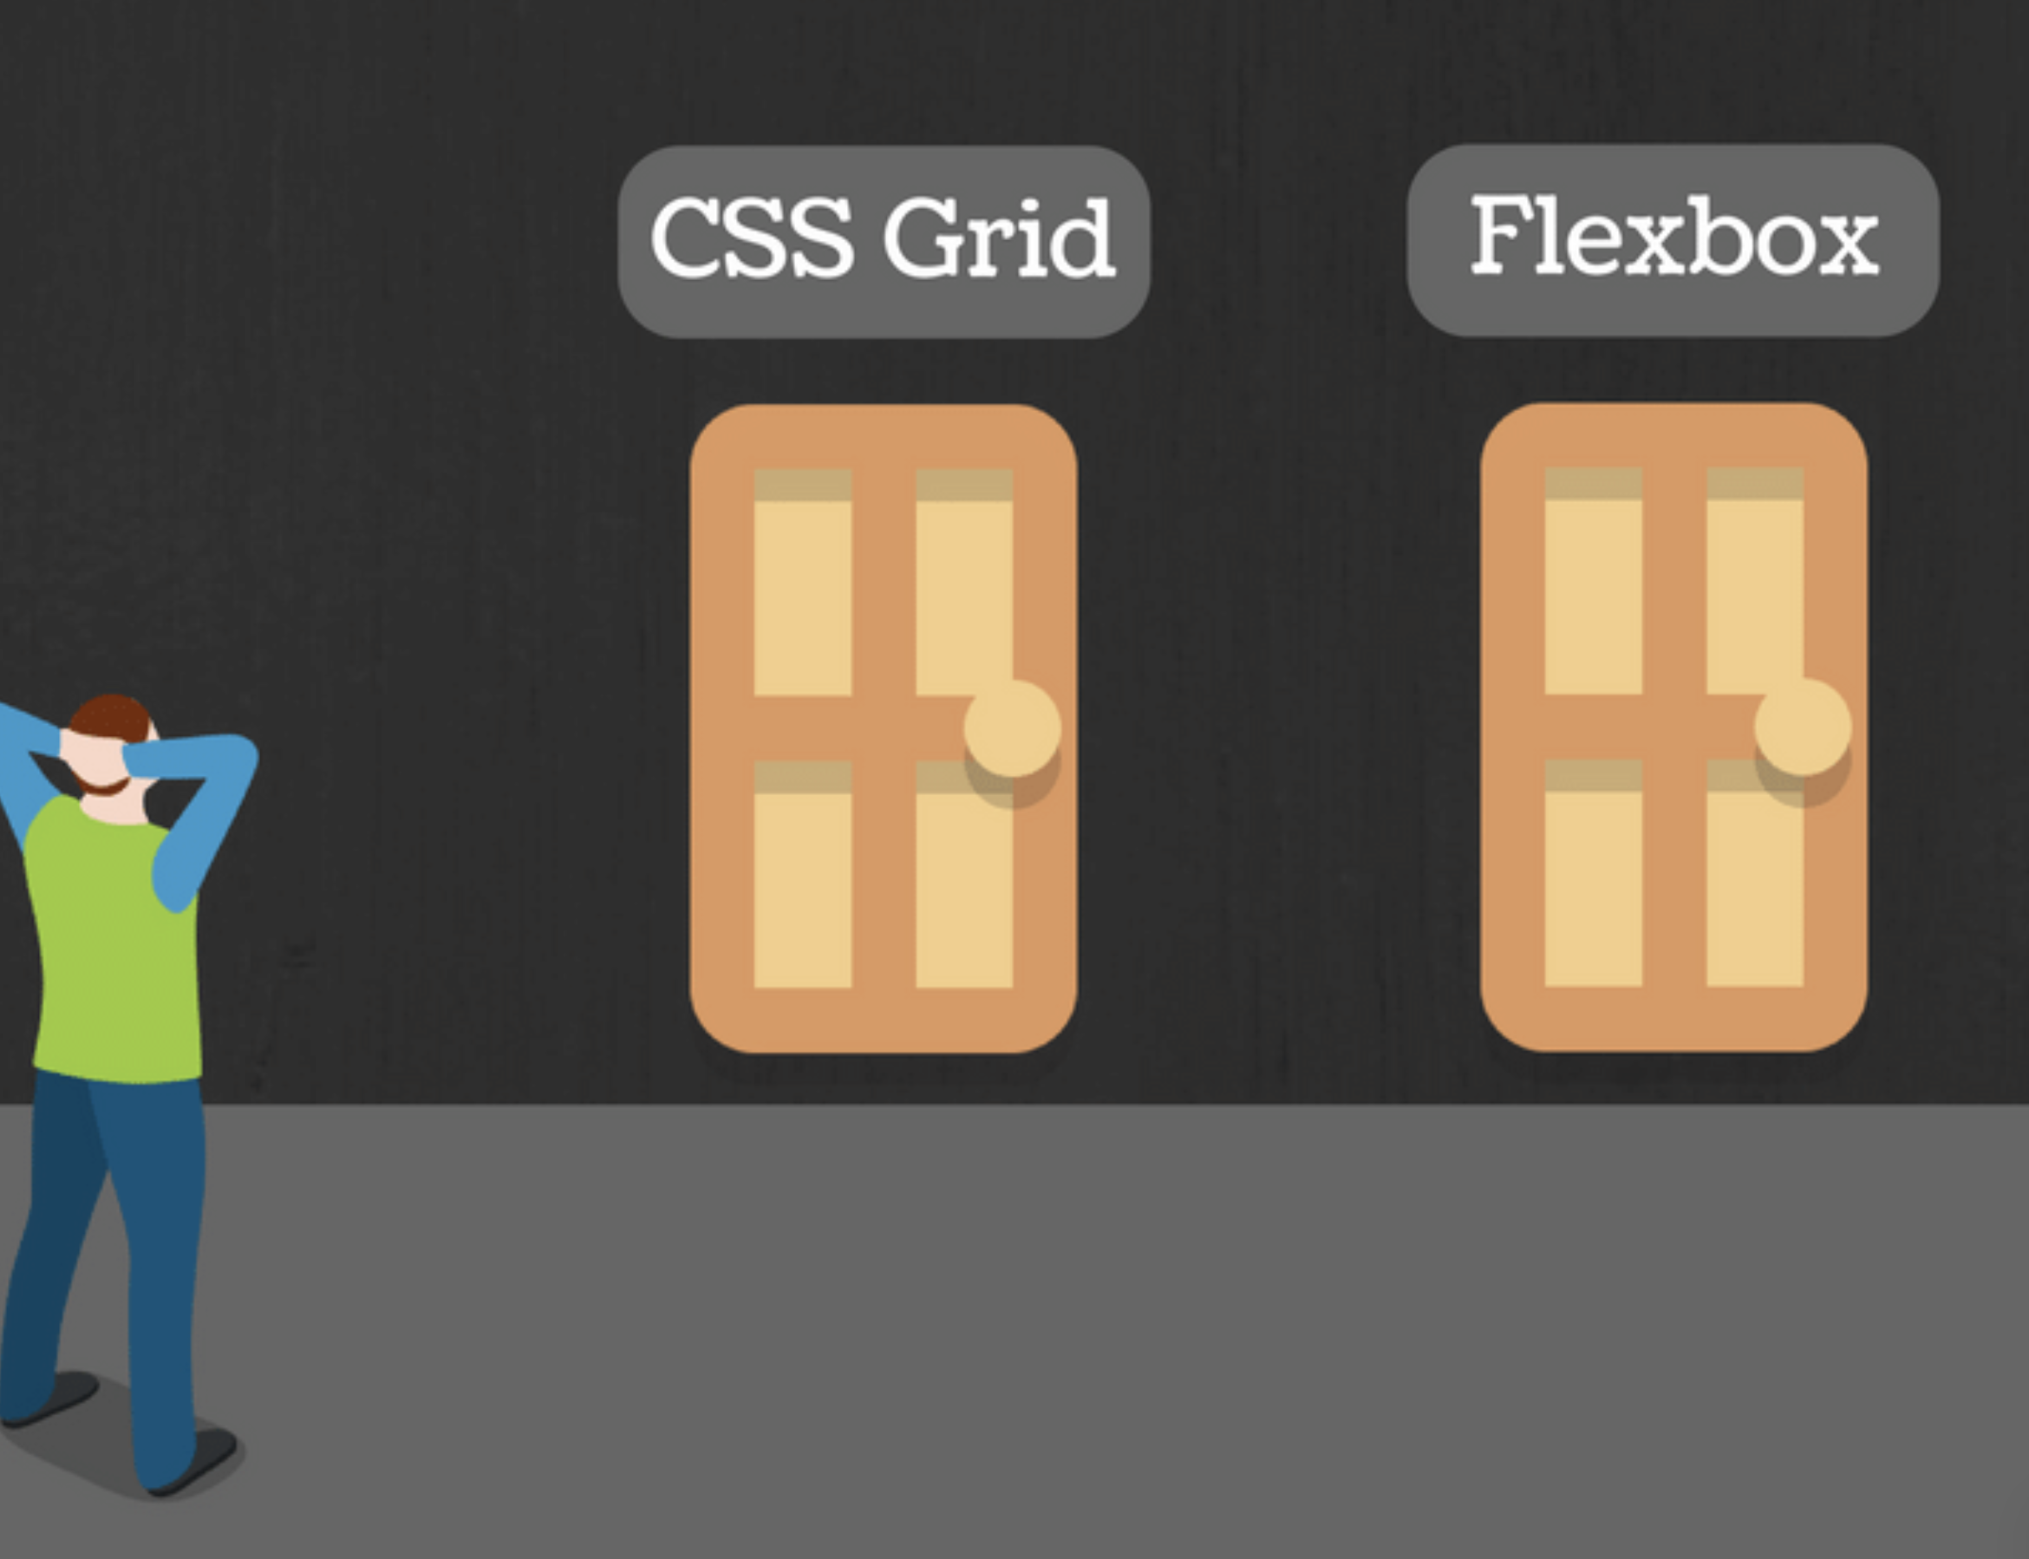
Grid or Flex?
Flex is intended for linear layouts
Flex most appropriate for individual components
Most are linear in nature
Grid is intended for large scale layouts that are not linear
two-dimensional
Grid is layout first, flex is content first
If you are well aware of content’s size better Flex, if not opt for Grid

Slide 11
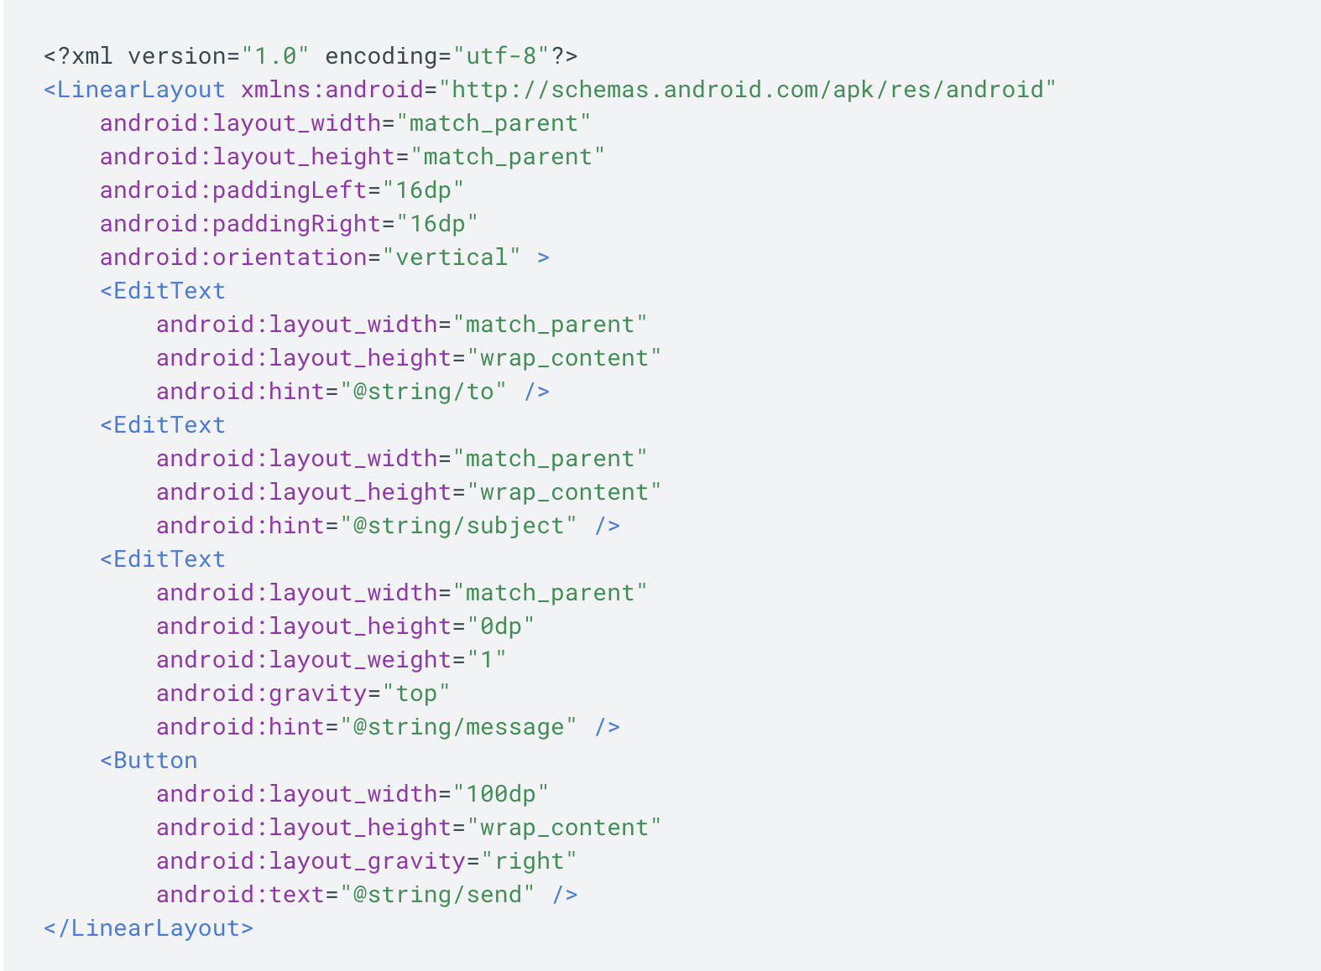
Mobile’s Version of Layouts
Android
LinearLayout
left to right
up and down
RelativeLayout
absolute
relative
iOS
StackView
samesis, left to right
up + down
Storyboard + Constraints
Drag/Place objects on storyboard in IDE UI
Add constraints to set them in a given spot

Slide 12
Sources
https://www.w3.org/TR/css3-grid-layout/#fr-unit
https://medium.com/youstart-labs/beginners-guide-to-choose-between-css-grid-and-flexbox-783005dd2412
https://css-tricks.com/snippets/css/complete-guide-grid/
https://css-tricks.com/snippets/css/a-guide-to-flexbox/
https://flexboxfroggy.com/
https://gridbyexample.com/
https://scotch.io/tutorials/a-visual-guide-to-css3-flexbox-properties

